Slide 1
Ecs289G002 SML Project Presentation
Generalization of Deep Learning Models on First-person Videos
Presenter: Wei-Chih Chen(Michael)
Group Members: Yu-Cheng Lin and Chia-Chih Ho
2015/12/01

Slide 2
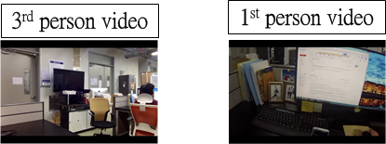
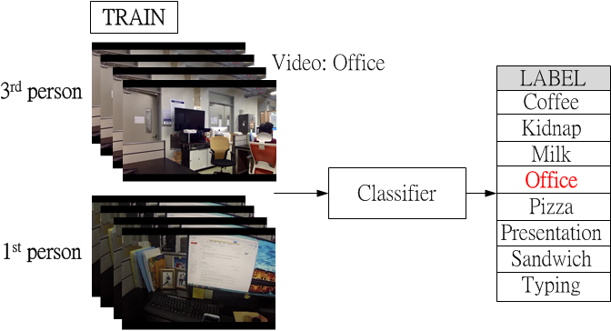
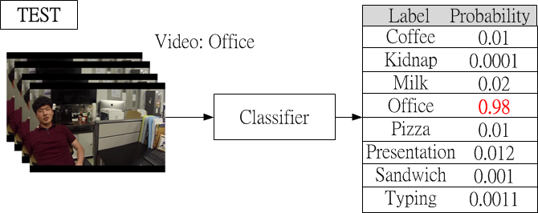
Introduction
Project goal: first person video classification.
2
1
3

Slide 3

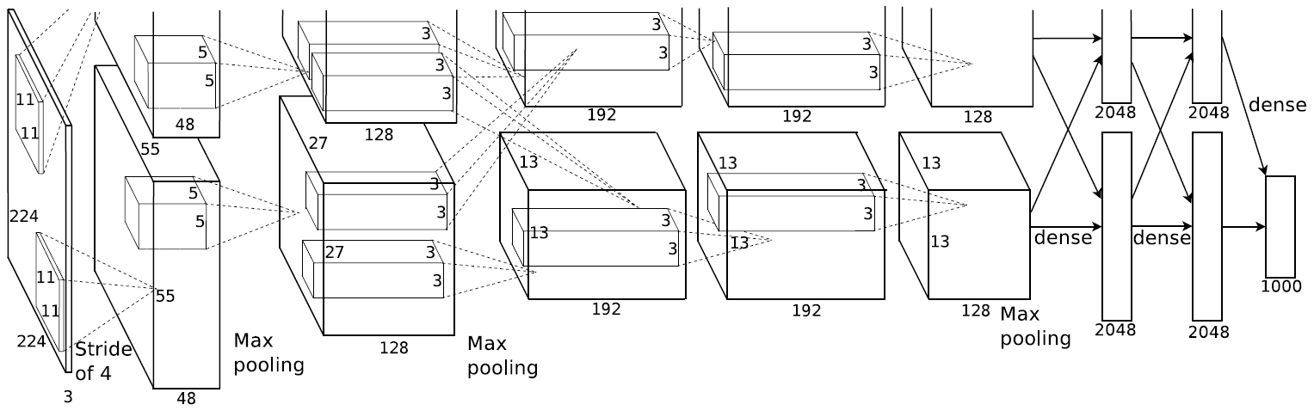
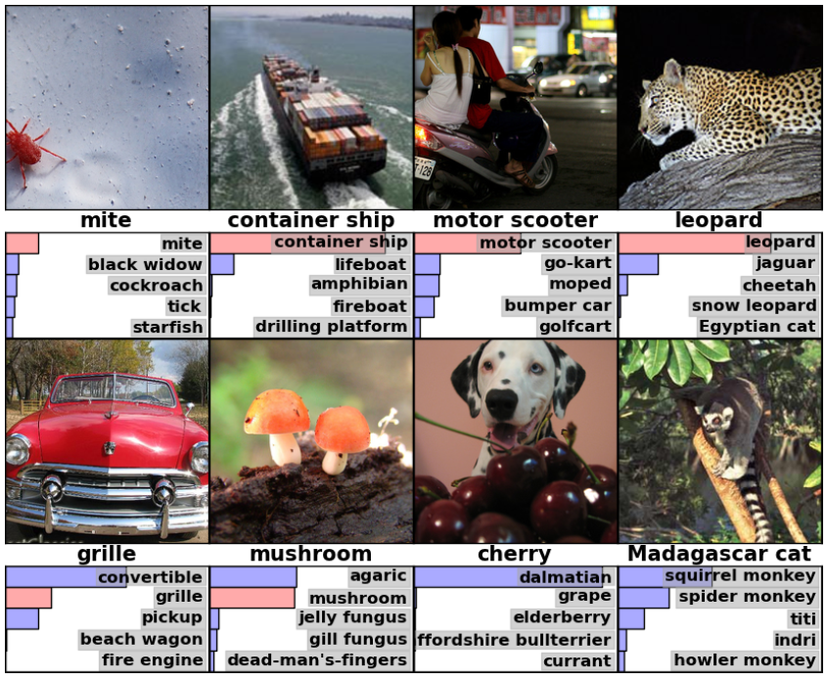
Introduction - Alexnet 2012
Neural Network did a tremendous success on image classification job.
Probability of 1000 classes
Image
TOP-5 error rate from 26.2%→16.4%

Slide 4
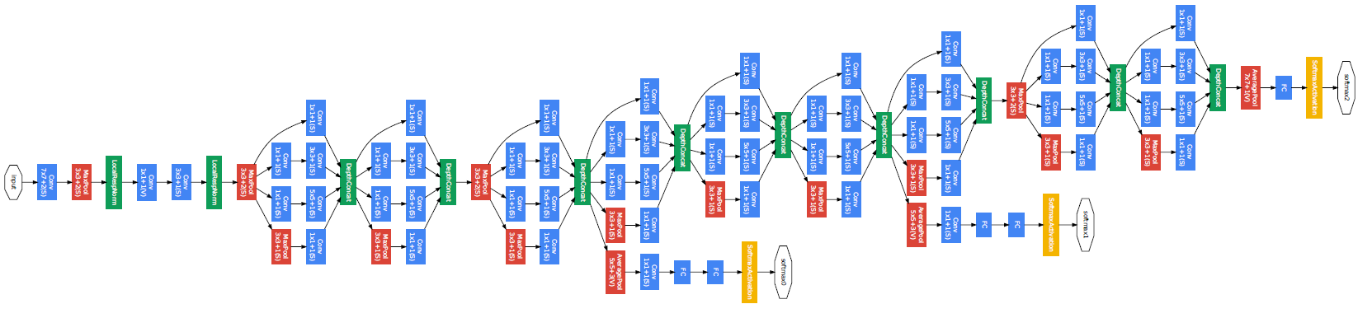
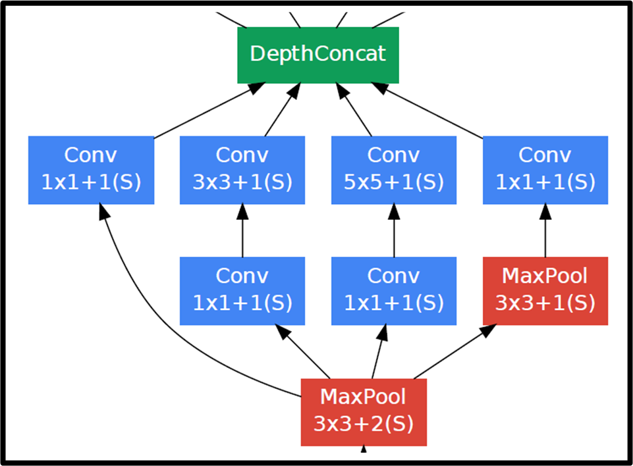
Introduction - Googlenet 2014
Image
Probability of 1000 classes
22 layers
Provide possible local spatial structure for convolution layers
TOP-5 error rate 6.67% Human ~5%(?)

Slide 5
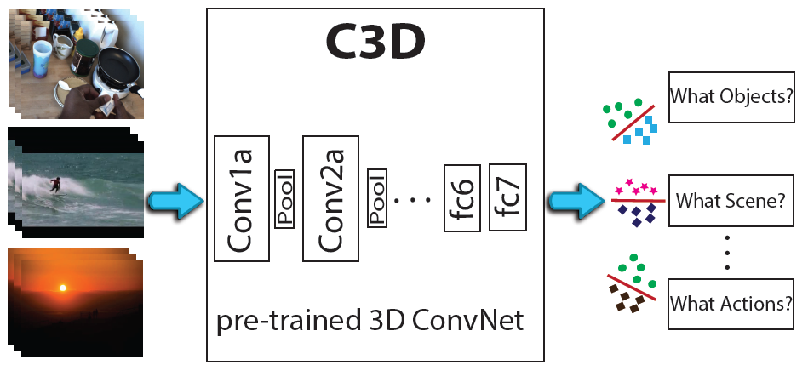
Introduction – 3D Conv. NN(C3D) 2014
Probability of 1000 classes
16 frames
16 frames
16 frames
Based on Alexnet
Consider time dimension – for video recognition

Slide 6
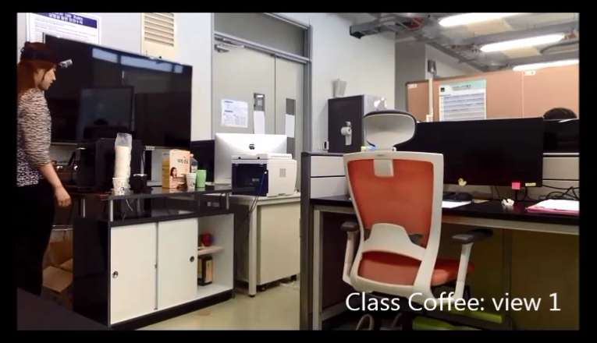

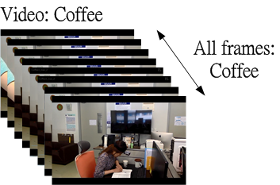
Dataset (1/2)
Label | Class | Video number
0 | Coffe | 18
1 | Kidnap | 56
2 | Milk | 3
3 | Office | 59
4 | Pizza | 15
5 | Presentation | 18
6 | Sandwitch | 13
7 | Typing | 9
 | Total | 191
Each scene took from 2 fix cameras and 1 GoPro.
(From Indiana University)

Slide 7
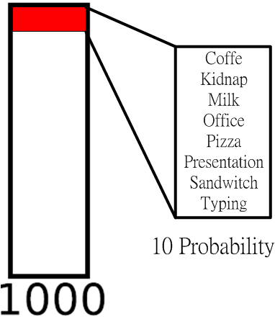
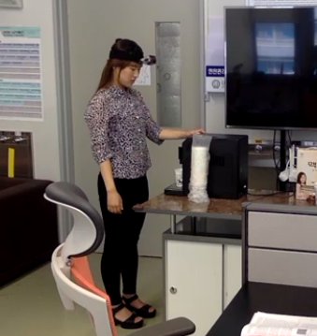
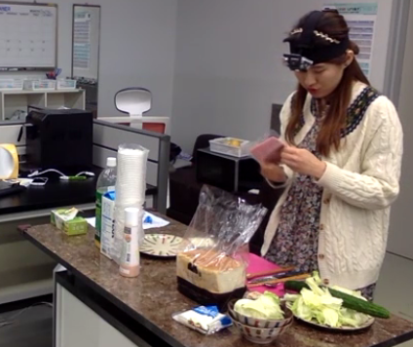
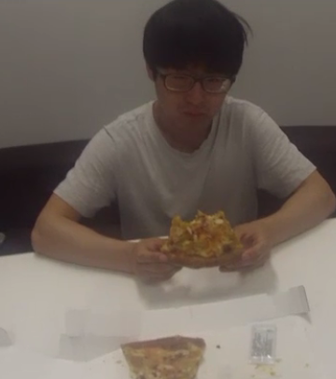
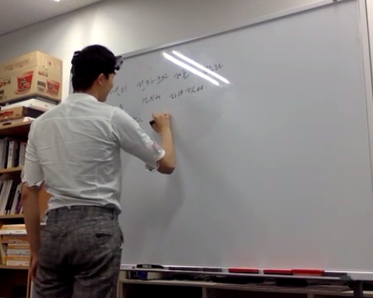
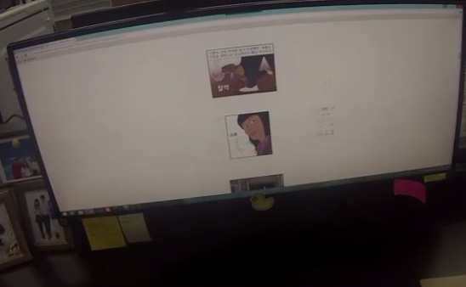
Dataset (2/2)
Using Caffe library (written in C++ )
Running on Linux
Each video ~4K frames with sample rate 1/10
Train : Test = 3 : 1

Slide 8
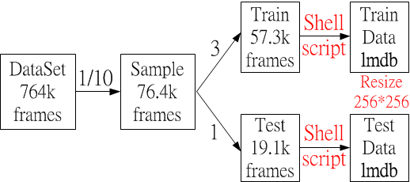
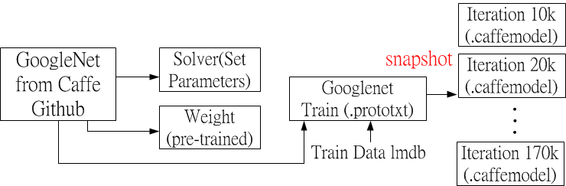
How to implement by Caffe - Train
SGD, batch size=32
GPU K40c
Fine-tune 170k iterations takes 36 hours

Slide 9
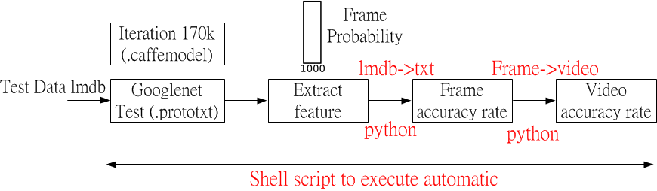
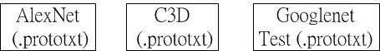
How to implement by Caffe - Test
We implemented 3 neural networks

Slide 10
Result(1/2) - GoogleNet
Iteration | Frame error | Video rate
10k | 0.7178185 | 0.68
20k | 0.735987 | 0.68
30k | 0.71834608 | 0.6
40k | 0.72738064 | 0.66
50k | 0.7173569 | 0.6
60k | 0.72230282 | 0.62
70k | 0.73160116 | 0.64
80k | 0.73113954 | 0.64
90k | 0.73311791 | 0.64
100k | 0.73015036 | 0.62
110k | 0.72955685 | 0.62
120k | 0.73199683 | 0.66
130k | 0.7339752 | 0.64
140k | 0.73186494 | 0.62
150k | 0.73133738 | 0.62
160k | 0.73166711 | 0.62
170k | 0.73160116 | 0.62

Slide 11
Result(2/2)
Based on iterations 20K
total | correct videos | video counts | accuracy
C3D | 25 | 33 | 0.7575
Alexnet | 34 | 50 | 0.68
Googlenet | 34 | 50 | 0.68
label type | Networks | Misclassify label
Coffee | Alexnet | 3 labeled as kidnap, 3 labeled as office
 | Googlenet | 2 labeled as kidnap, 4 labeled as office
Kidnap | C3D | all labeled as office
 | Alexnet | all labeled as office
 | Googlenet | all labeled as office
Office | C3D | all labelled as kidnap
Sandwich | Alexnet | all labeled as pizza
 | Googlenet | all labeled as pizza

Slide 12
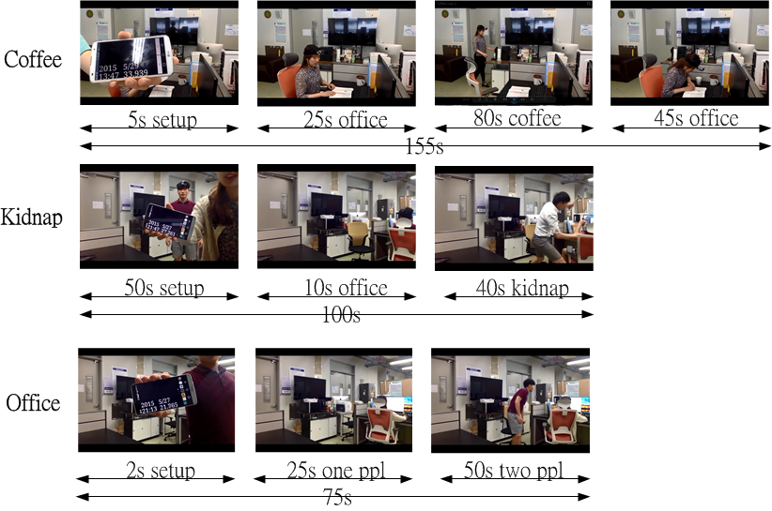
Analysis(1/2)
label type | Networks | Misclassify label
Coffee | Alexnet | 3 labeled as kidnap, 3 labeled as office
 | Googlenet | 2 labeled as kidnap, 4 labeled as office
Kidnap | C3D | all labeled as office
 | Alexnet | all labeled as office
 | Googlenet | all labeled as office

Slide 13
Analysis(2/2)
GoogleNet → local feature on different sizes well → More iterations not help → good at getting local features for frames → not improve on videos
C3D →More time features →Better on video classification

Slide 14
Conclusion
Neural Network is also good at video classification with first person video and 3rd person video.
→ 76% C3D, 68% Alexnet and 68% Googlenet
Need more dataset in quantity and in quality to improve training for avoiding overfitting. → We implement only 191 videos.
Try to implement new network or loss function to improve accuracy rate.

